Slide 1
Virtual Hand Realism Affects Object Size Perception
in Body-Based Scaling
Authored by:
Alexandre Oliveira, 93289
Raquel Pinto, 92948
MIECT - IHC
16/5/2021
Information about paper:
Authors: Nami Ogawa, Takuji Narumi and Michitaka Hirose
( The University of Tokyo)
Publication: 23-27 March, Osaka, Japan
Date: 2019
Number of pages: 10
Notes:
Raquel

Slide 2

Paper selection
Virtual reality (VR) - “is a computer simulated experience that can be similar to or completely different from the real world”.
Research
Understand problematics
Technological innovation
100 % Immersive VR
Notes:
Raquel

Slide 3
Introduction of the problem
It is important to identify and analyse the effects of avatars on user perceptions.
The appearance of virtual hands influences our sense of embodiment.
A hand very similar to a human hand we have a stronger sense of ownership of the body
The size of the object is affected by the size of the body -> body-based scaling -> Increasing the size of the virtual hand results in decreasing the perceived sizes of objects.
The more realistic the virtual hands are, the stronger the sense of ownership of the body, which promotes sizing.
This paper is the result of the investigation of the effect of virtual hand realism as the size of a virtual object is perceived based on the size of the virtual hand.
Notes:
Raquel

Slide 4
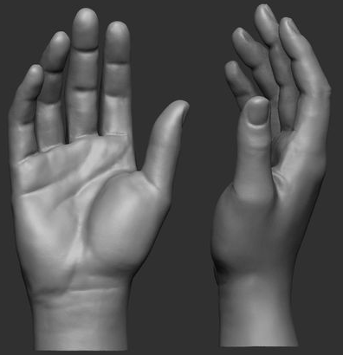
Important effects
Effect of Avatar Realism on Self-body Perception:
Rubber hand illusion (RHI)
Virtual hand illusion (VHI)
The more similar the avatar is to us, the stronger the sense of ownership of the body
a realistic virtual forearm increases the sense of ownership
Effect of Body Representation on Spatial Perception:
The change in body size influences the perception of distances and size in the virtual world
Uncanny Valley effect
Generic 3DCG virtual hands
Notes:
Alex

Slide 5
Expected Result
H1 -> The object size is perceived to be smaller with the enlarged virtual hand than with the veridical virtual hand when the virtual hand is realistic.
H2 -> The less realistic the virtual hands, the weaker the sense of body ownership.
H3 -> The less realistic the virtual hands, the less the impact of changes in hand size on the object size estimation.
H4 -> The participants with higher scores of body ownership tend to perceive the object size as smaller when the virtual hand is enlarged.
Notes:
Alex

Slide 6
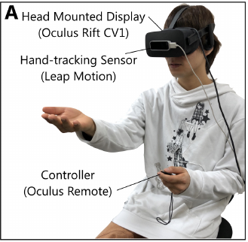
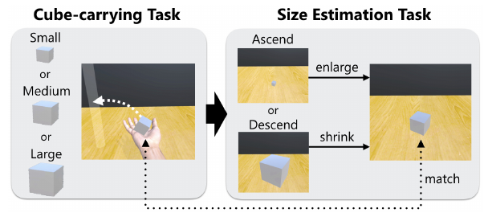
Experiment
It inverts how the size of a virtual object is perceived based on the size of the virtual hand.
To do this, the participants transported cubes to a cylinder and then, using a controller that adjusts the size of the cube, tried to create a cube of the same size.
Participants: 24 people -> 12 men and 12 women (20 to 36 years old).
The device they used had the ability to detect the person's hand and arm to create avatars of the same size.
Notes:
Raquel

Slide 7
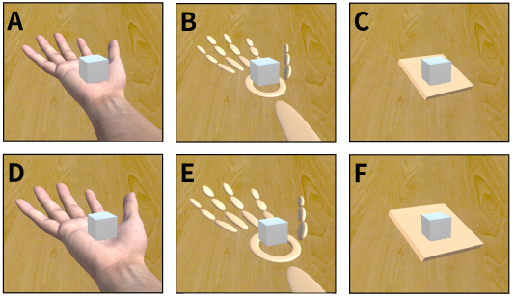
Experiment
Three types of hands:
Realistic hand (High realism).
Robotic hand (Medium realism).
Abstract hand (Low realism).
Two types of hand sizes:
Veridical size.
Enlarged size.
Cube sizes:
Small (5 cm);
Medium (7.5 cm).
Large (10 cm).
Size-adjustable cube:
1 cm (ascending series) to 15 cm (descending series).
Notes:
Raquel

Slide 8
Experimental Procedures
Two Parts:
First participants carry randomly sized cubes to a cylinder with virtual hands.
Second with a command the participants adjust the size of the cube.
These tasks have no time limit and for each experiment the difference in size between the cube in the hand and the cube drawn was recorded.
Questionnaire with 9 questions and answers from -3(strongly disagree) to 3 (strongly agree).
22 valid data sets.
Notes:
Raquel

Slide 9
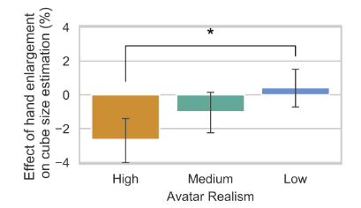
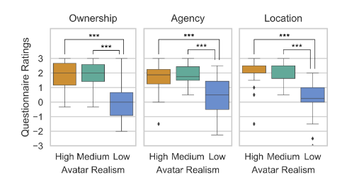
Results
The hand enlargement caused the object to look smaller with the realistic hand [H1].
The less realistic the virtual hands, the less the impact of changes in hand size on the object size estimation [H3].
The less realistic the virtual hands, the weaker the sense of body ownership [H2].
Medium level of realism was similar to the high level of realism.
Notes:
Alex

Slide 10
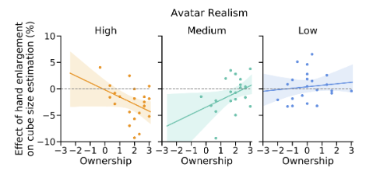
Results
These results did not fully support [H4]
a negative correlation was found for the high-realism avatar, as expected, but the opposite was found for medium-realism avatar.
Notes:
Alex

Slide 11
Conclusion
The results showed that “perceived object sizes are underestimated only when a realistic virtual hand is used in the case where the virtual hand is enlarged”.
Also, the sense of embodiment (including body ownership) is strongly affected by the realism of the avatar.
To end, self-avatar appearances strongly affect how we perceive virtual body and also virtual spaces.
The size of body representation in VR is a fundamental metric to scale the size of objects properly

Slide 12
Bibliografy
Paper -> https://ieeevr.org/2019/program/papers.html#papers30
Figure slide 2 -> https://sites.google.com/site/roteiromatrixhistoria
Figure slide 4-> https://www.pinterest.pt/pin/719731584171497193/

